Slide 1
Behavior Management System
Kindergarten- Second Grade

Slide 2
The System
Behavior effects the entire school day. If behavior is out of control, then it makes learning difficult for everyone. We use a stoplight system in our class to track our behavior. Rewards are also establish for students who maintain positive behavior. Students will be given their behavior sheet everyday with what color they ended on. Parents should sign this sheet daily.

Slide 3
The Colors
Green
Yellow
Blue
Orange
Purple
Red

Slide 4
Where to find their Behavior…….

Slide 5
Penalties
Green is for wonderful behavior
First Time (yellow): Name of board (warning)
Second Time (blue): One check- 10 minutes Teacher Detention
Third Time (orange): Two checks- 20 minutes Teacher Detention
Fourth Time (purple): Three checks- 30 minutes Teacher Detention and parents called
Fifth Time (red): Four checks- 45 minutes Teacher Detention, referral written, and student sent to the office
* Severe disruptions: Students sent immediately to the office.

Slide 6
Citizenship Grade
Greens If your scholar has this amount of green days, they will receive the corresponding grade. | Citizenship Grade
45-38 | E
37-30 | S
29-22 | N
Less that 22 | U

Slide 7
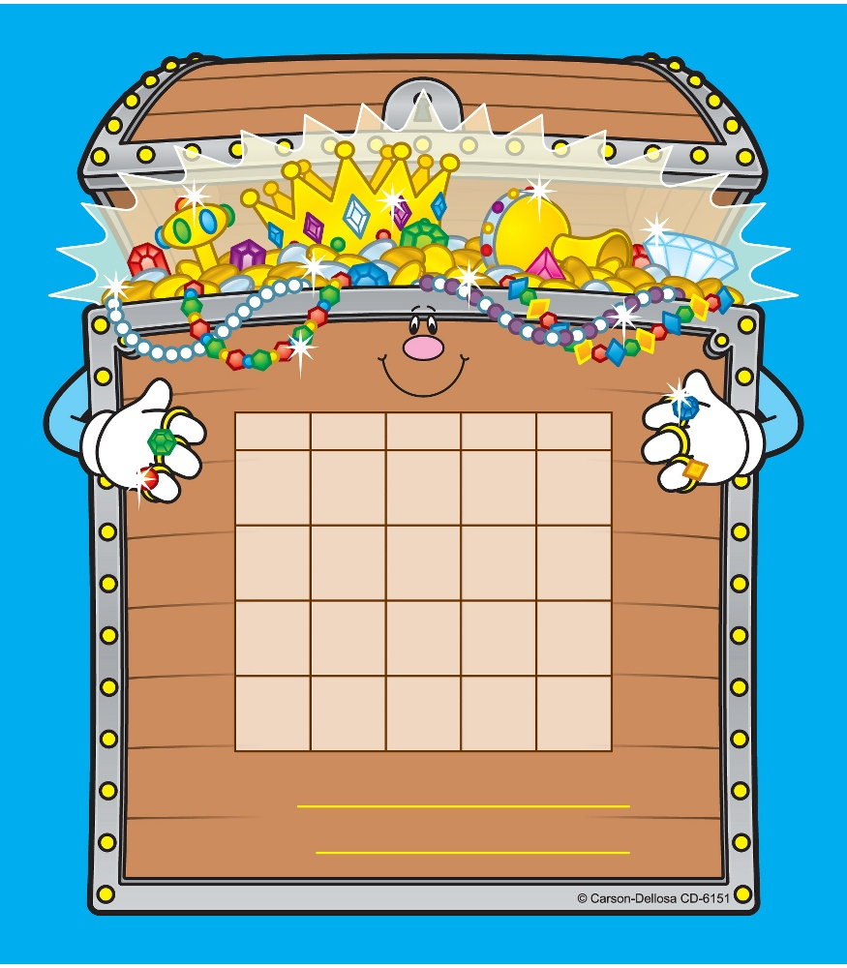
Incentive Chart
Starting in January,
teachers will keep a chart
with students behavior.
Each day we will chart
what color the students
earned for the day. This
will determine their
citizenship grade.

